Slide 1
INTERNSHIP PROCESS FOR 2D YEAR MASTER STUDENTS
Career Center
HSE GSB
2024

Slide 2
STAGES AND TERMS OF PRACTICE
5
After the internship, submit the necessary documents to the Programme Office
Go for an Internship: Terms of Practice for all programs:
09.01.2025-13.03.2025
4
Wait for a response from the company (up to 10 working days after they receive your CV) and follow the recruitment process (HR interview, test, etc.) (approx. 3 weeks and up to a month)
3
1
2
Independent search:
choose a company and a vacancy for an internship, fill out a form unil December 1, 2024 for concluding an agreement for practical training
Internship from the Career Centre: Unil December 1, 2024 apply for internships posted on GSB Telegram group and follow the recruitment process offered by the Company. You may select vacancies of mass recruitment or limited places of practice (see different sections)
1

Slide 3
CHOOSING THE FORMAT AND PLACE OF THE INTERNSHIP
Internship options
Internship from the Career Centre:
The Career Center provides information on vacancies for practice. The student applies for internships posted on GSB Telegram group and follows the recruitment process offered by the Company. Please pay your attention that even though you apply for vacancies from Career Centre, you should also continue search by yourself to increase your chances to find a place for internship.
Independent search/Current job:
The student finds the internship on his/her own and submits the form until December 1, 2024 to conclude an agreement for practical training with the Organization
1
2
Please note that students can not intern with Individual Entrepreneurs, relatives or in their own companies. See all criteria on slide 4
3
Internship supervisors
From the university
On behalf of the university, the supervisor of the internship is the scientific supervisor of your thesis paper.
From a company
On behalf of the company, the internship supervisor is the supervisor/manager whom you directly report.
2

Slide 4
Requirements for companies for internship
1
It is not allowed to do internship with an individual entrepreneur or in a company owned by the student or a relative of the student (heirs of the first and second stage)
The number of employees of the organization is at least 50 people, the company’s revenue for the previous calendar year is at least 100 million rubles. If the company does not meet the criteria, it must be a part of an international/Russian network of firms
A company must exist for at least three years by the time a student internships in it.
1.1
2
2
3
3
If the chosen company does not meet the specified criteria, the student must justify the need for internship in the submitted organization and get a written resolution from the Academic Supervisor. You need to write an email to the Academic Supervisor in a free format and get his consent with your place of internship. Then forward the consent letter to careers@hse.ru.
3

Slide 5
I am doing an internship at my current place of work or I have found an internship by myself
Documents
1st step
Check if the criteria of chosen organization for internship meet the requirements
2nd step
Find out from the company the tasks you will do as part of your internship. Get approval from your supervisor at HSE. Fill in your tasks in an individual assignment, sign it with your supervisor
3^{d} step
Fill in the LMS application form for internship until December 10, 2024
4th step
Fill in the form until December 1, 2024, a CC employee will contact the company and sign the agreement
5th step
Wait for response from the CC (10 working days for applications; ~3 weeks if it’s a new contract). Then take the documents to the company for signature and stamp and bring 1 copy of the original document to the CC (signed and stamped by the company) until January 15, 2025
6th step
After the internship, submit internship documents to the Program Office using SmartLMS
Before internship submit to CC
After internship submit to the Program Office
Fill in the form
Internship report
1
Individual Assignment
Employer's feedback
Individual Assignment
2
Deadlines
Until 01.12.2024 – fill in the form for the conclusion of the contract Until 10.12.2024 – Fill in the LMS application form for internship
Unlil 27.12.2024 – fill in and upload the signed individual assignment to SmartLMS
Until 15.01.2025 – bring the contract/appendix signed by the company to the Career Centre
Until 20.03.2025 – submit a report, review and individual assignment signed and graded by your supervisors to the Program Office using SmartLMS
3
4

Slide 6
INTERNSHIP FROM THE CAREER CENTER
Documents
1 step
Choose vacancies on the CC Telegram and apply until December 1, 2024. All changes in the selection status for vacancies with a limited number of places will be sent to the email you specified in the application form.
2 step
Wait for the initial feedback from the Company on the results of CV screening (up to 10 working days after they receive your CV).
3 step
After passing the CV screening, continue the selection for the chosen internship: interview with HR, testing, interview with the hiring manager. There may be a different number of selection stages for different positions.
4 step
The company is ready to make an offer. Find out from the company the tasks you will do during your internship. Fill in your tasks in an individual assignment, get approval from your practice supervisor at HSE and sign it.
5 step
Fill in the LMS application form for internship until December 10, 2024
6 step
After the internship submit internship documents to the Program Office using SmartLMS
Before internship
After internship
Individual assignment
Internship report
1
Employer's feedback
Individual assignment
2
Deadlines
3
Until 20.03.2023 – Fill in the LMS application form for internship
Before internship – fill in and sign an individual assignment (it remains with the student, there is no need to submit it anywhere. It serves as a written confirmation that your internship supervisor agrees with your tasks for internship)
During one week after internship – submit a report, review and internship diary to the Program Office
Until 10.12.2024 – Fill in the LMS application form for internship
Unlil 27.12.2024 – fill in and upload the signed individual assignment to SmartLMS
Until 20.03.2025 – submit a report, review and individual assignment signed and graded by your supervisors to the Program Office using SmartLMS
5

Slide 7
NO ANSWER FROM SELECTED COMPANIES, I DON’T HAVE A PLACE FOR INTERNSHIP. WHAT TO DO?
If you understand that it’s 3 weeks before the internship and you have no response or 2-3 refusals from the companies where you applied, see below alternative options for finding an internship in which the CC is not involved, i.e. it is an independent search:
You can find offers in the "internships" or "careers" section on the website of the company you are interested in
Internship at HSE. Ask your supervisor if there are any suitable options for you, discuss the assignment with him
Look for and apply for internship vacancies on the GSB Careers Centre (make sure the employer can sign your practice docs when you apply)
There are project and research laboratories at HSE. Contact the head of the unit and find out if there is an opportunity to participate in ongoing projects
1
2
3
4
6

Slide 8
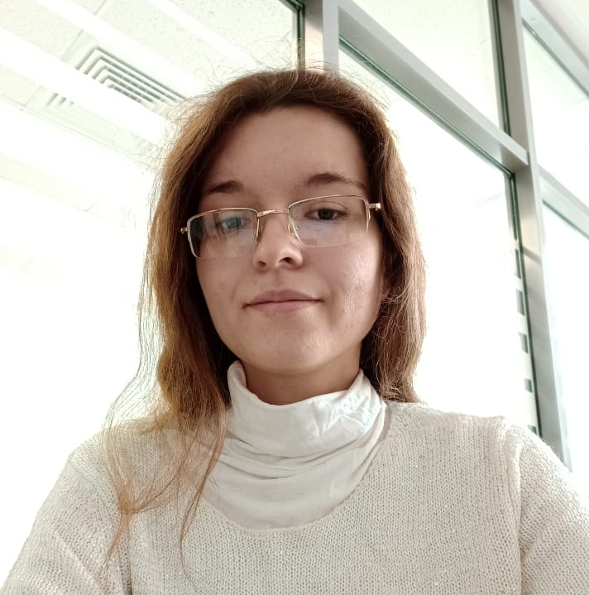
CONTACTS FOR COMMUNICATION
We kindly request: before you write your question, see the Q&A section. Most likely, it has already been answered :)
How to get an answer to a question:
Visit our Career Center and ask in person. Office 4401, from 10:00-17:30 on weekdays
2. By mail: careers@hse.ru
Any questions about the internship
3. Elena Kovaleva
Mail: enkovaleva@hse.ru
Questions about internship agreements
For important information read the channel* Зимняя практика магистратура
7

Slide 9
Q&A AGREEMENT
AN EXAMPLE OF A COMPLETED AGREEMENT HERE
Please do not staple it when you bring it to CC
Who in the company is the Assurance of circumstances to be filled in?
To the supervisor of the internship
Is it necessary to fill in the Assurance of Circumstances?
Yes
How many copies of the agreement are required?
Two. One for the CC and one for the company
Can an electronic signature be put on the contract?
Only in exceptional cases - the student is studying online or he is not in Russia
What can I do if my organisation's supervisor is not authorised to teach?
The contract does not talk about teacher training. For more details, see question 9 here
Can I send the original contract to the CC by courier?
Yes, but notify the CC member of staff before
Do I have to add the date to the contract?
No, you do not need to. The CC will do it itself
8

Slide 10
Q&A AGREEMENT
The company has asked for an adjustment to a clause in the contract. Is this possible?
Send the contract corrected by the company to careers@hse.ru and they will tell you if it is possible to make changes
If the practice is online, do I have to enter the premises?
If in point 1.3 distant practice format is chosen, then Annex 2 should be deleted and numbering corrected in points 2.2.3 and 4.7.
Appendix 3 with certifications becomes Appendix 2
The company requests a power of attorney for the signatory from the HSE. What to do?
Request it at careers@hse.ru and it will be sent to you
Who should sign first: the company or HSE?
HSE
What should I write in the appendix to the Agreement for Practical Training No. ____?
Do not fill it in
9

Slide 11
Q&A OFFER/ACCEPTANCE LETTER
AN EXAMPLE OF A COMPLETED OFFER LETTER FOR IS HERE
What is an offer for?
It may be needed if a company cannot sign the usual form of contract
Do I have to bring the original letter of acceptance to the CC or can I take a scan?
The original is required
How does the offer/acceptance letter scheme work?
You fill in an offer, send it to careers@hse.ru. Once you receive confirmation within 10 working days you can collect it from the CC and take it to the company. The company will sign the letter of acceptance. Bring the acceptance to the CC
Q&A REPORT AND FEEDBACK
Who signs the Internship Report and Review?
The report - your supervisor at the company and your supervisor form HSE
Review - manager in the company
Q&A INDIVIDUAL ASSIGNMENT
Why do I need an individual assignment if I don't have to hand it in anywhere?
You need it so that you can have confirmation that your placement is suitable for your program. The supervisor will sign the Individual assignment in case the Program Office has any questions when you receive the practice credit
10

Slide 12
Q&A INTERNSHIP IN HSE
I am doing an internship at the HSE / with a supervisor. What documents do I have to hand in?
To have a signed individual assignment, to hand in a report, a review and an internship diary to the Program Office after the internship. You don’t need an agreement
My supervisor is unaware of the supervised practice format. What to do?
Contact the Program Office
Q&A LMS
Made a mistake in LMS / had to change company and already submitted an application. What to do?
Questions about LMS should be addressed to the Program Office, CC cannot change anything on this platform
Is it necessary to attach scans of any documents to LMS?
No, you do not need to. There is no "*" in these fields
LMS does not find GRN of the company, says wrong post
Contact technical support of LMS
Where can you find PRIN (ОГРН) of organization / legal address?
This information is freely available on the Internet
11

Slide 13
Q&A OTHERS
Where is the CC and when can I hand in my documents?
26 Shabolovka Street, room 4401. On weekdays from 10:00 to 17:30
Can I do an internship in a foreign company?
Yes, you can. For other information, please come to office 4401
How do I know my supervisor?
They are assigned by your Program Office, contact them
Does the internship imply that I need to get a job in a company/employment relationship between the student and the organisation?
No
Who is the internship coordinator/ supervisor from the company?
The one who gives you the tasks, checks their fulfilment. Your supervisor
Is it better to ask questions about internship to official of organization coordinating internship or to supervisor of internship?
If it is a question about the tasks and/or the internship itself, yes, at this stage it is better to contact a supervisor from the organization.
If it is a question about an individual task, then it is better to contact the supervisor from the HSE
12

Slide 14
GSB Career Center
E-mail: careers@hse.ru

