Slide 1
emlyon business school
2021-2022

Slide 2
"Anticipate, guide, support and give meaning to the far-reaching changes in the world. This is the mission emlyon has set out to achieve through its Confluence 2025 strategic plan, in a bid to be one of the top 15 Global Business Universities in Europe."
Isabelle Huault, Executive President and Dean, emlyon business school.

Slide 3
Contents
emlyon: facts & figures
Academic excellence
Social and environmental responsibility
International influence and renown
Programmes for exchange
Agora Gerland 2024

Slide 4
emlyon: facts & figures

Slide 5
Globally-ranked business school
emlyon: facts & figures
Founded in 1872 – 150 years in operation in 2022
A globally-ranked institution (FT, THE, …)
among the 1% to hold triple accreditation by AACSB, EQUIS and AMBA
Our community
Over 8,900 students and 6,000 in continuing education
121 nationalities
35,700 alumni in 130 different countries
Geographical presence
Our historic campus in Ecully, plus St-Etienne & Paris
4 international campuses: Shanghai, Casablanca, Bhubaneshwar and Mumbai
190 academic partners around the world
Top 40 Global Employability University Times Higher Education 2020
Top 20 European Business School Financial Times 2020

Slide 6
emlyon: facts & figures
Early makers since 1872
A notion of teaching geared towards initiative and decision-making
The Early Makers signature teaching style
entrepreneurial ethos: initiative & decision
experience, experimentation and action
Projects (creation, consultancy, …)
Business games
In-company experience
Physical locations for tangible teaching activities
The "makers' labs": Prototyping with Fab, makers'project factory, bootcamps, etc.
Incubator, accelerator
Learning hub
"DOING TO LEARN AND LEARNING TO DO"

Slide 7
Learning by doing
emlyon: facts & figures
Close-up on the key spots for early makers
Makers’ lab: A laboratory for designing and prototyping
Learning hub: digital library
Incubator & accelerator
4 makers labs: Ecully, Paris, Casablanca, Saint-Etienne (Shanghai under development)
Over 800 training courses (4000 people)
Over 700 prototype projects
5 learning hubs: Ecully, Shanghai, Paris, Saint-Etienne and Casablanca
121,560 journals and newspapers
5,417 emlyon papers
70,000+ books and e-books
64 databases
71 startups incubated and 95 accelerated in 2020
Over 250 entrepreneurial projects supported each year
Over 1,400 businesses created or taken over and over 13,000 jobs directly created since 1984

Slide 8
emlyon: facts & figures
Explore here, make now.
Our calling
To produce and share the knowledge that will enable us to address the social, digital and ecological issues facing organizations, and reveal the lifelong skills of responsible managers, capable of grasping the complexity of the world and transforming the society in which they operate.
Confluences 2025
A strategic plan that places responsibility at the center of the school's development, to develop its academic excellence along with its action for the common good. Four main areas: hybridization, social & environmental responsibility, internationalization and digitalization; 60 concrete initiatives to reach the top of the European business university rankings.
Our objective:
BE ONE OF THE TOP 15 GLOBAL BUSINESS UNIVERSITIES IN EUROPE BY 2025

Slide 9
emlyon: facts & figures
Governance
Executive Board
Isabelle Huault Executive President and Dean
Annabel-Mauve Bonnefous Dean of Programs
Tessa Melkonian Dean for Faculty and Research
Nicolas Péjout Director of Strategy & Development
Bruno Tallent Head of Communication, Marketing and Business Relations
A pioneering legal status and capital structure
emlyon business school is the first business school to have included private investors on its governance team in France. Since 2018, it has been a Public Limited Company with an Executive Board and a Supervisory Board.
emlyon became a Benefit Corporation in July 2021.
Two boards were added to the governance team in 2021: an International Advisory Board (for academic matters) and a Corporate Advisory Board (for business matters).

Slide 10
Academic excellence

Slide 11
Our programmes
Academic excellence
Lifelong learning
Undergraduate & Postgraduate
Doctoral programmes
Executive Education
Global BBA
MSc in Management – Grande Ecole
Specialised MSc Programmes
International MBA
PhD programme
Global DBA
Degree and certificate courses for executives (Executive MBA)
Degree and certificate courses for managers (EMMG)
Certificates
Online courses
In-company and tailored courses

Slide 12
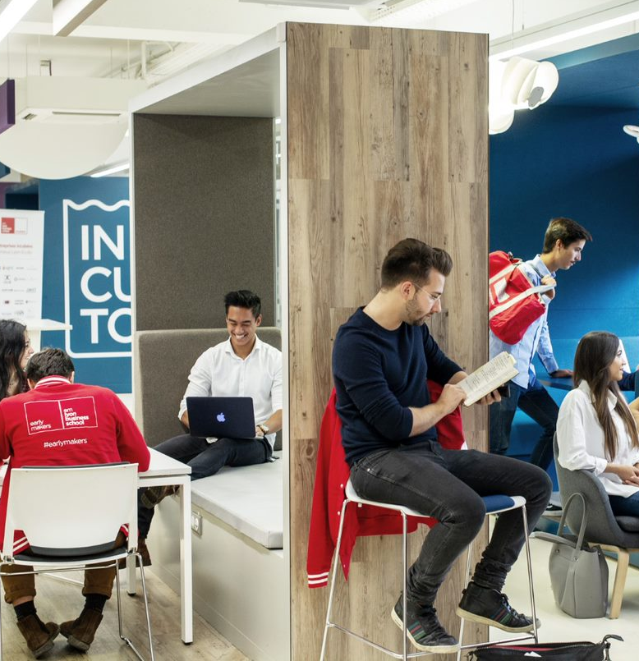
Academic excellence
Creation and hybridization: core components of the programmes
emlyon sees learning as a series of "learning experiences" that eliminate the barriers between disciplines, between academic and entrepreneurial activities, between formats, etc.
Academic hybridization
Academic partnerships with renowned establishments in other disciplines (art, engineering, politics, etc.)
Makers'labs and special programmes for experimenting...
Digital hybridization
Opening knowledge with online learning platforms
20% of training course modules will be online by 2021
The priority: employable students and lifelong learning for makers, equipped to create a sustainable society

Slide 13
Academic excellence
Faculty and Research
emlyon's faculty is responsible for maintaining the School's academic excellence. Its rich research output permeates and stimulates the scientific conversation worldwide.
Faculty
Faculty members representing a variety of disciplines, from data science to the humanities and social sciences
160 full professors (soon 200), 48% of whom are international, aiming for 40% of women professors by 2025
Research
Hybridization and impact are its watchwords and method
A standard-setting global scientific stakeholder, with over 230 published papers classified A or B over the past five years
6 research centers and 1 institute
Horizon 2025: 3 new institutes
- AI & Management Institute
- Social Innovation Institute
- Ethno-Institute

Slide 14
Social and environmental responsibility

Slide 15
Social and environmental responsibility
Training responsible leaders
emlyon has built the notion of social and environmental commitment into all of its programs to give students a more thorough grounding in the stakes involved in "greening", social sustainability and ethics.
Sustainable Development Goals Inside
Skills repository of all training programs revised to factor in the UN's 17 Sustainable Development Goals, and creation of the "SDGs Inside" label
Dedicated programs
"Climate Action" course now mandatory for the MSc in Management – Grande Ecole program and shortly for the Global BBA
Specific MS and MSc in... programs created in the field, on a partnership basis

Slide 16
Social and environmental responsibility
Benefit corporation
emlyon's primary purpose, as a higher-education establishment, is to act in the general interest by training the stakeholders the world needs today and in the future. We are fully committed to this calling and have accordingly adopted the status of a benefit corporation from July 2021.
A comprehensive commitment
Under the French "Pacte" Act (Action plan for the growth and transformation of businesses), emlyon will write its business purpose and its CSR objectives into its articles of association, to serve as an everyday decision guide and long-term goal.
A collective project
The project, which involves all of the school's stakeholders, promotes co-construction with a mixed Steering Committee, set up to provide food for thought and prompt fresh initiatives.
July 2021: Officialization of the school's "benefit corporation" status

Slide 17
Social and environmental responsibility
Inclusion and diversity
Our primary responsibility is to open our school to all forms of diversity as a means of guaranteeing the richness of the courses and experiences we hope to see at emlyon.
Grants and apprenticeships
To be able to open its doors to all student profiles, the school relies on two initiatives:
Its apprenticeship training center, to encourage cooperative education
Its Foundation and various grants
Special programs
To extend beyond its potential student populations and reach as many profiles as possible, emlyon has set up other study pathways:
The "TUMM", multi-campus multi-district social program
Its Digital Qualification School, "la toile".
Our goal for 2025:
30% students receiving grants
500 apprentices

Slide 18
International influence and renown

Slide 19
International influence and renown
An international ecosystem
emlyon is firmly establishing its international footprint through campuses designed to operate as hubs anchored in their local ecosystems, and through prestigious partnerships.
Present across the world
After Lyon, Saint-Etienne, Paris, Casablanca, Shanghai and Bhubaneswar, a 7th campus has opened in Mumbai
An establishment in Latin America is planned in the near future
Partnerships
190 – soon 200 – international academic partnerships distributed over 50 countries will enable nearly 2,000 emlyon students to study in prestigious, top-ranking establishments abroad, such as UCLA or Berkeley.
50% of international, mobile faculty members on the campuses
10 new international double degrees by 2025

Slide 20
International influence and renown
The alumni network
The school's 35,700 alumni form a tight-knit network that extends to the four corners of the world. They are the school's foremost ambassadors abroad. Over 350 events and digital or in-person meetings each year cater for a vibrant community.
The ambassadors
250 volunteer "ambassador" alumni coordinate the network around over 80 geographic and thematic communities: clubs, circles or groups for a particular sector, profession or field of interest...
"Advancement & Alumni Relations" department
This department is dedicated to raising funds and coordinating the network to generate fresh synergies between businesses and within the alumni community.
35,700 alumni
130 countries
350 events

Slide 21
Programmes for exchange

Slide 22
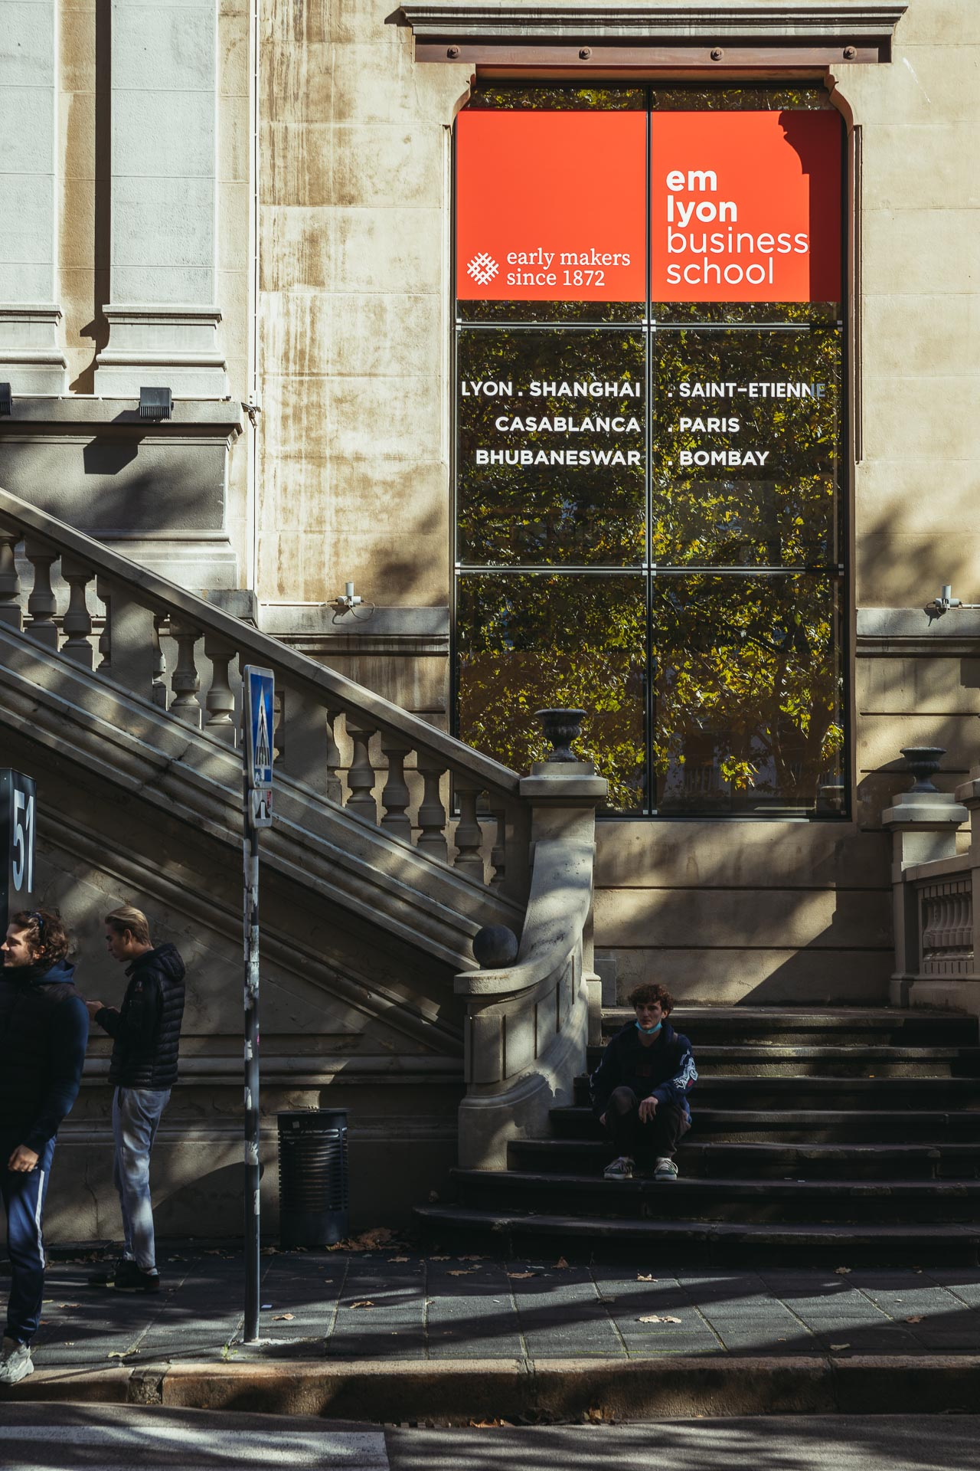
Programmes
Global BBA
The Global BBA, a Bachelor’s programme, is designed to prepare and arm young students to become true actors in the transformation of firms and the world of business. It will develop both personal and professional skills that will allow you to support organizations and society throughout these mutations (mental agility, international openness …) and become an early maker.
Key characteristics
Skills development in all fields & 360° perspective on business issues
Action-based learning programme: experimentation & strong project-based skills
An understanding of digital technology from a technical & business perspective
International dimension
Facts & Figures
Saint-Etienne campus
Programme taught in French & English. All Year 3 & 4 courses in English
960 students across 4 years
67 nationalities

Slide 23
Programmes
Global BBA – Course outline
All 4 years of the Global BBA programme are made up of core courses, elective courses, major fields of study, together with a variety of learning experiences including group projects, business games, on-the-job learning modules and internships. In order to give exchange students a flexible offering, the timetable allows you to mix blocks of courses from both the 3rd and 4th years.
Year 3: Exploring complexity, different environments, multicultural contexts
Core courses (15 ECTS): AI for business / Int’l Business / Data Management Development,
Business Game (2.5 ECTS)
Business Challenge (2.5 ECTS)
Electives (10 ECTS): Advanced IB, Digital Platforms, etc.
Year 4: Developing Strategic Insight / Business Specialisation
Core courses & Group Project (15 ECTS) developing a strategic business perspective focussing on industry analysis and competitive advantage
Major (20 ECTS) enabling students to acquire a deeper knowledge of a specialised area of business ➔
Major concentrations:
Digital Marketing (F)
Finance & Control (F/S)
International Business (F/S)
Branding & Communication (F)
Corporate Entrepreneurship & Innovation (F)
Creative Technologists (F)
Supply Chain Management (F)
(F = Fall / S = Spring)
Semesters: Fall (September – December) / Spring (February – May) Workload: 25 – 35 ECTS / semester

Slide 24
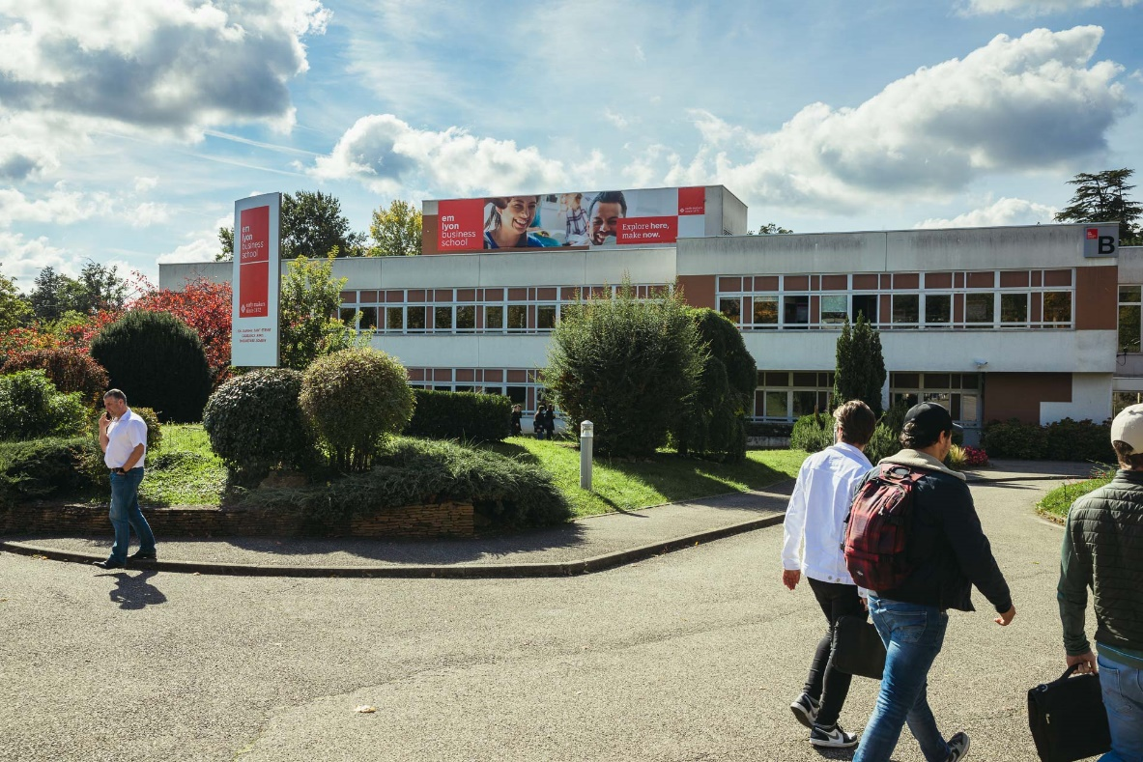
Programmes
MSc in Management - Programme Grande Ecole
The MSc in Management or Grande Ecole programme is the traditional flagship programme of emlyon business school, training the future young managerial elite for French and international companies. The educational infrastructure mobilises different modes of learning and experimentation (“Do to learn, learn to do”) and encourages students to make the connections necessary for action: connections between reflection and action, between courses and research, the challenges and disruptions of the present world and your studies, …
Key characteristics
Ensuring graduate employability: internships, careers workshops, apprenticeship, …
À-la-carte elective options & progressive specialisation
Signature Early-Makers DNA courses: Designing with Web, Sustainable Futures, PCE-Business Creation Project
Hybridisation through double degree programmes (Engineering, Law, Politics, Arts, …)
International dimension
Facts & Figures
Lyon Ecully campus
Programme taught in French & English.
Approx. 100 electives on offer: ca. 75 in English ca. 25 in French
6,100 students in postgraduate programmes (specialised MSc / MS programmes)
107 nationalities

Slide 25
Programmes
MSc in Management – Elective course offering
Exchange students can expect to enjoy an offer of approximately 100 elective courses across all major fields of management, of which roughly 75% are taught in English and roughly 25% in French. Almost all courses grant 5 ECTS. The principle areas of study are:
Accounting / Finance
Global Capital Markets
Financial Diagnosis
Financial Decision-making
Quantitative Finance / Economics
Topics in Economics for Strategy
Commodities & Credit Derivatives
Portfolio Management
Innovation & Entrepreneuship
Social Entrepreneurship
Innovation & Entrepreneurship Perspectives
Innovation at the Bottom of the Pyramid
New Venture, Growth & Development
Marketing
Marketing Strategy
Negotiating Complex Trade Situations
Quantitative Marketing Analysis
E-Commerce & E-tailing
Strategy & Business Model
Global Strategies
Non-market Strategy
Economic Strategy & Competitiveness
Social Sciences & Humanities
Power & Politics
The Power of Storytelling
Science & Technology in an Age of Controversy
Human Relations & Regulation
Managing International Teams
Management of Intellectual Property Rights
EU Competition Law
Digital Business Law
Operations, Data & AI
Economics of Digital Ecosystems
Logistics Management
Python Data Analysis
Introduction to AI: Machine Learning for Business
Semesters: Fall (September – December) / Spring (January – April) Workload: 20 – 30 ECTS / semester

Slide 26
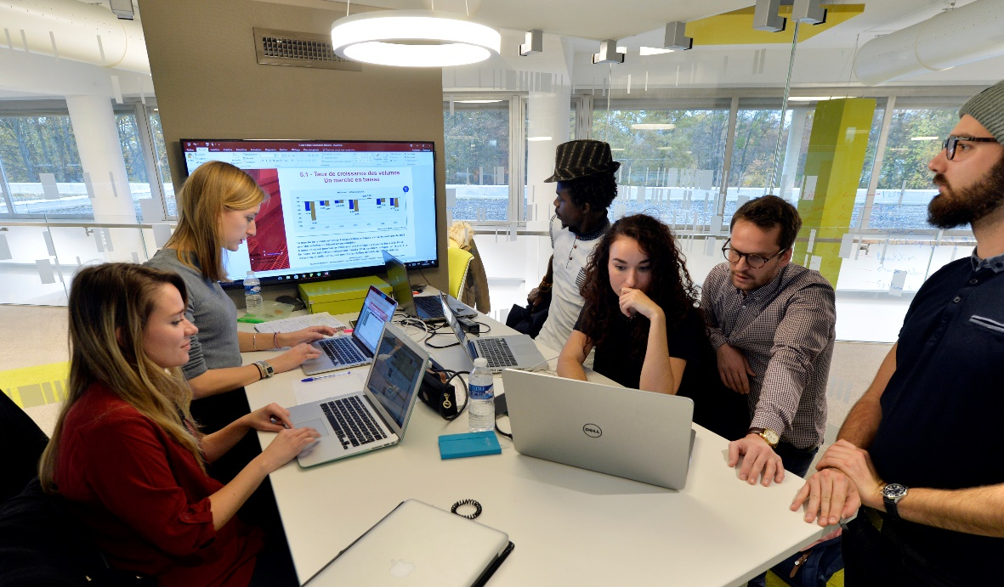
Programmes for exchange
Summer School 2022
This programme is designed for graduate students who want to examine the finer issues of advanced business practices in an international context.
Module 1: Advanced Strategy (June 13th – 24th, 2022)
Module 2: Branding (June 27th – July 8th, 2022)
Advanced Strategy (Kira CHOI)
Central issue: Why do some firms outperform other firms?
Drivers of inter-industry profitability & effective strategy-making
Competition within industries: understanding intra-industry, inter-firm profitability and indicators of performance
Corporate strategy: choice of industry / market, options for effective strategy
Societal context and the constraints on strategic choices
Branding (Lionel SITZ)
How brands function and their socio-cultural significance
What branding means and its implications for the company as a whole
Study of brands in the consumer goods market, but also in other industries
Cultural Activities
River-boat tour of Lyon
Confluence Museum
Company visits: BioMérieux, Renault Trucks,….

Slide 27
Agora Gerland 2024

Slide 28
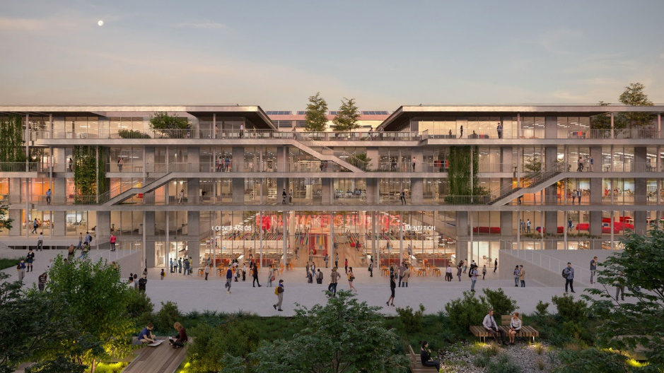
Digitalization
The Gerland Campus: bringing emlyon's ambition to life
Future hybrid campus
To be inaugurated in January 2024, the new emlyon campus was designed to be a unique venue for learning and networking, at the crossroads of the professional and academic worlds, at once local and international, physical and digital.
At the forefront of creativity, it will embody the various facets of emlyon's ambition, in particular in terms of digitalization, its firm establishment in the life of the City and connection with the social-economic communities.
30,000 m2 €17 million invested in phygital facilities

Slide 29
Thank you

