Slide 1
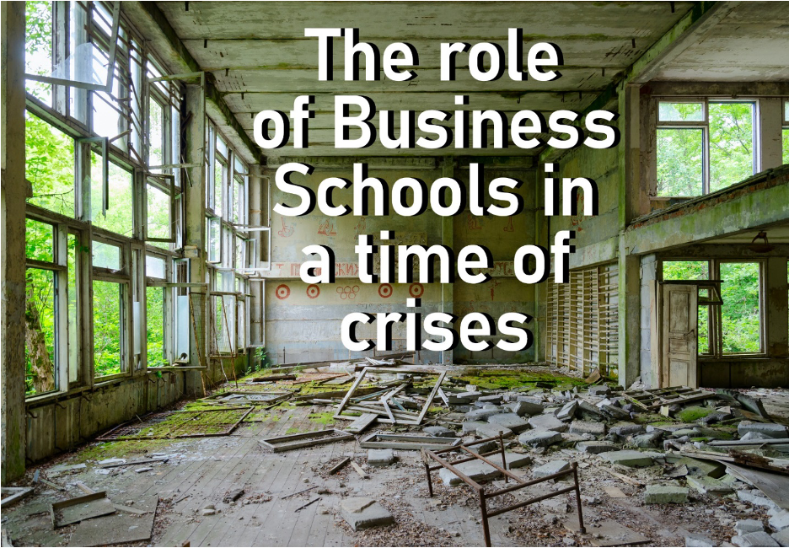
When Students Rate the Positive Impact of Business Schools…
FROM BEING THE BEST IN THE WORLD TO BEING THE BEST FOR THE WORLD!
PIR 2022 Edition

Slide 2
WHY DOES IT NEED THE PIR? WHAT IS THE IDEA BEHIND THE PIR?
Measuring the positive impact of business schools
Capturing the voice of students
From ranking to rating, from competition to collaboration
Enabling school development
Tool for social impact measurement

Slide 3
Who is behind the PIR? https://www.positiveimpactrating.org
PIR association, endorsers & supporters, student organizations, partners
PIR
Association
PIR SUPERVISORY BOARD
PIR ADVISORY BOARD
Katrin Muff
The Institute for Business Sust.
Mathias Falken-stein/Xolas
Sophie Charrois oikos Internat.
Thomas Dyllick
The Institute for Business Sust.
Carlo Giardi-netti/Franklin
Léo Gillard
WWF CH
Ruth Mhlanga
Oxfam GB.
Jonas Haertle
UNITAR
Antonio Hautle UNGC CH
Urs Jäger
VIVA IDEA
Dan LeClair
GBSN
Robin Schimmel-pfennig/ Fehr Advice
PIR MANAGEMENT TEAM
John Watt
Giuliana Longworth
Partners
Endorsed & supported
International Student Organizations
Environment
Society
Economy
Notes:
The PIR was created by concerned business school experts together with global NGOs - WWF, Oxfam, UN Global Compact - and international student associations. It is supported by VIVA Idea and Fehr Advice.

Slide 4
Dual Value Proposition
PIR as a rating tool and a tool for supporting school development
Rating tool
Capturing the voice of your students
Analyzing your school’s performance
Benchmarking your school
Communicating positive impact
Supporting school development
Social impact measurement
Learning from other PIR schools
Empowering students
Student-staff collaboration

Slide 5
The Positive Impact Rating Model 3 areas, 7 dimensions, 20 questions, scale 1 to 10 (zero option)
Areas | Dimensions | Questions
Energizing | Governance | 2 questions
 | Culture | 4 questions
Educating | Programs | 4 questions
 | Learning Methods | 3 questions
 | Student Support | 3 questions
Engaging | Institution as a Role Model | 2 questions
 | Public Engagement | 2 questions

Slide 6
PIR RATING 2022 Performance across the PIR levels
Level | Range | Characterization | Disclosed
Level 1 | 1.0 – 4.2 | Beginning | No
Level 2 | 4.3 – 5.8 | Emerging | No
Level 3 | 5.9 – 7.3 | Progressing | Yes
Level 4 | 7.4 – 8.7 | Transforming | Yes
Level 5 | 8.8 - 10 | Pioneering | Yes

Slide 7
PIR RATING 2022 Rated schools by level and in alphabetic order
LEVEL 5 – PIONEERING SCHOOLS (4)
IIM Bangalore, India | S P Jain Institute of Management & Research, India
Woxsen University School of Business, India | XLRI Xavier School of Management, India
LEVEL 4 – TRANSFORMING SCHOOLS (29)
Aalto University School of Business, Finland | Fairleigh Dickinson University Silberman College, USA | Luiss Business School, Italy
Abu Dhabi School of Management, United Arab Emirates | Fordham University Gabelli School of Business, USA | Maastricht University School of Business and Economics, Netherlands
Antwerp Management School, Belgium | Glasgow Caledonian University, UK | Nova School of Business and Economics, Portugal
Audencia Business School, France | Grenoble Ecole de Management, France | Rennes School of Business, France
Carleton University Sprott School, Canada | HKUST Business School, Hong Kong | St.Petersbusrg University, Graduate School of Management, Russia
CENTRUM PUCP Business School, Peru | IESEG School of Management, France | Strathmore Business School, Kenya
Colorado State University Fort Collins, USA | INCAE Business School, Costa Rica | Universal Business School, India
Deakin University Business School, Australia | Iscte Business School, Portugal | University of Vermont Grossman School of Business, USA
EADA Business School, Spain | Jyväskylä University School of Business and Economics, Finland | UPF-Barcelona School of Management, Spain
Esade Business School, Spain | Kozminski University, Poland
LEVEL 3 – PROGRESSING SCHOOLS (12)
Amsterdam University of Applied Sciences International Business School, Netherlands | EDHEC, France | Jönköping International Business School, Sweden
Concordia University John Molson School of Business , Canada | HEC Paris, France | KEDGE Business School, France
EAE Business School, Spain | HSE University Graduate School of Business, Russia | University of Colorado Boulder Leeds School, USA
Ecole Hôtelière de Lausanne, Switzerland | ICHEC Brussels Management School, Belgium | University of Gothenburg School of Business, Sweden

Slide 8
WHAT DO THE STUDENTS WANT? What my school should STOP doing
Using single-use plastics on campus
Unsustainable food and catering services on campus
Courses without practical sustainability skills included
Practices that continue to create waste
Offering degrees without mandatory sustainability courses
Teaching outdated theories and models of econo-mics and business

Slide 9
WHAT DO THE STUDENTS WANT? What my school should START doing
Providing practical sustainability competencies
Teaching sustainability and responsibility in a wider number of courses, programs, and classes
Listen to the student voice and engage with students
Engaging with nonprofit organizations for courses, projects, and career options
Updating curricula to include 21st century theories and models of business and economics
Paying attention to student health, well-being, and personal challenges

Slide 10
[School] PIR level 2022
Level 3: Progressing Demonstrating evidence of results across some impact dimensions

Slide 11
[School] PIR level 2022
Level 4: Transforming ​ Positive impact culture, embedded in governance and systems, with visible results and progress in many impact dimensions

Slide 12
[School] PIR level 2022
Level 5: Pioneering ​ Unique, sustaining global leadership progress in all impact dimensions

