Slide 1
POSITIVE IMPACT RATING 2021 Edition

Slide 2
Capturing the voice of students to
The Positive Impact Rating seeks to contribute as a lever of change to the transformation of the business school landscape.
Define the positive impacts of schools
Move from competition to collaboration
Provide a new tool for change

Slide 3
The PIR Value Proposition
Measuring
Connecting
Changing
Students seeking an education that prepares them as change makers in the 21st century get a global measurement of schools equipping them with the required competences.
Enabling civil society to find leading business school as like-minded partners in their endeavors and offers advice to business and other organizations on their impact.
Allowing schools to use the survey results as a tool for their internal change processes which serves for benchmarking, business school development

Slide 4
The Impact Model for Student Assessment
3 Areas, 7 Dimensions, 20 Questions
ENERGIZING
How governance and culture move the school ahead, as perceived by its students.
EDUCATING
The fundamental role of a school by preparing students to become responsible leaders in business and society.
ENGAGING
Reflects the school’s active engagement to earn the trust of students and society, but also its status as a respected public citizen.

Slide 5
Who is behind the PIR?
PIR SUPERVISORY BOARD
PIR ADVISORY BOARD
Katrin Muff
Thomas Dyllick
Mathias Falkenstein
Léo
Gillard
Ruth Mhlanga
Sophie Charrois
Carlo Giardinetti
Jonas Haertle
Urs
Jäger
Antonio Hautle
Dan
LeClair
Robin Schimmel-pfennig
Endorsed & Supported by:
Environment
Society
Economy
Student Organisations
Partner
Data Management
PIR MANAGEMENT TEAM
John Watt
Giuliana Longworth
Notes:
The PIR was created by concerned business school experts together with global NGOs - WWF, Oxfam, UN Global Compact - and international student associations. It is supported by VIVA Idea and Fehr Advice.

Slide 6
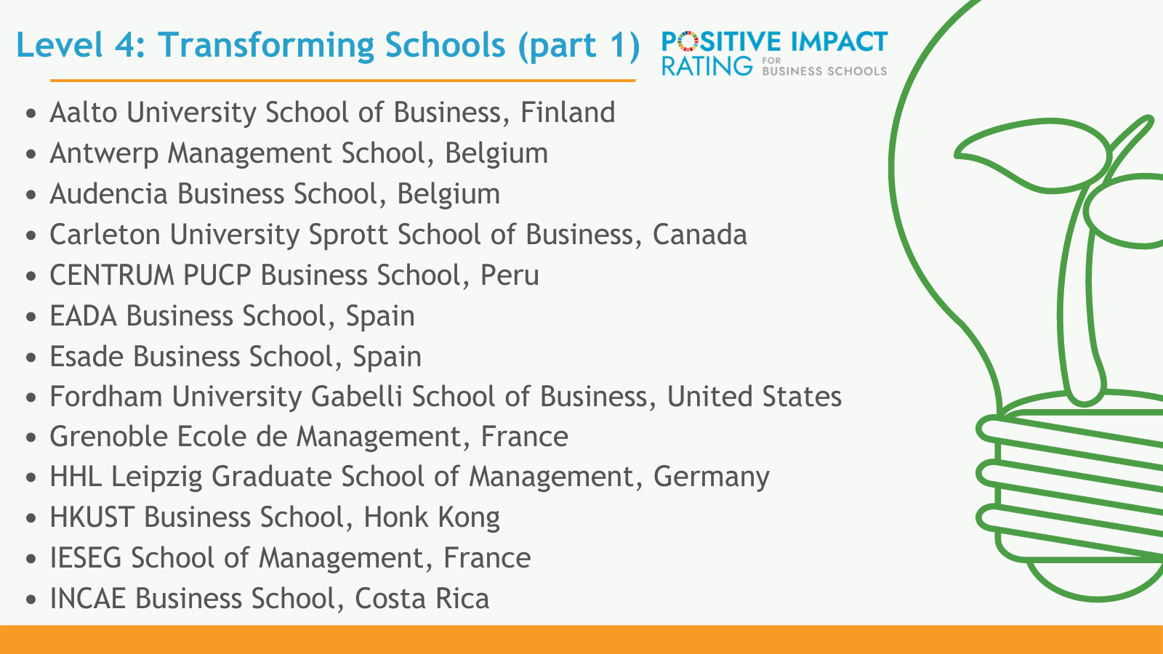
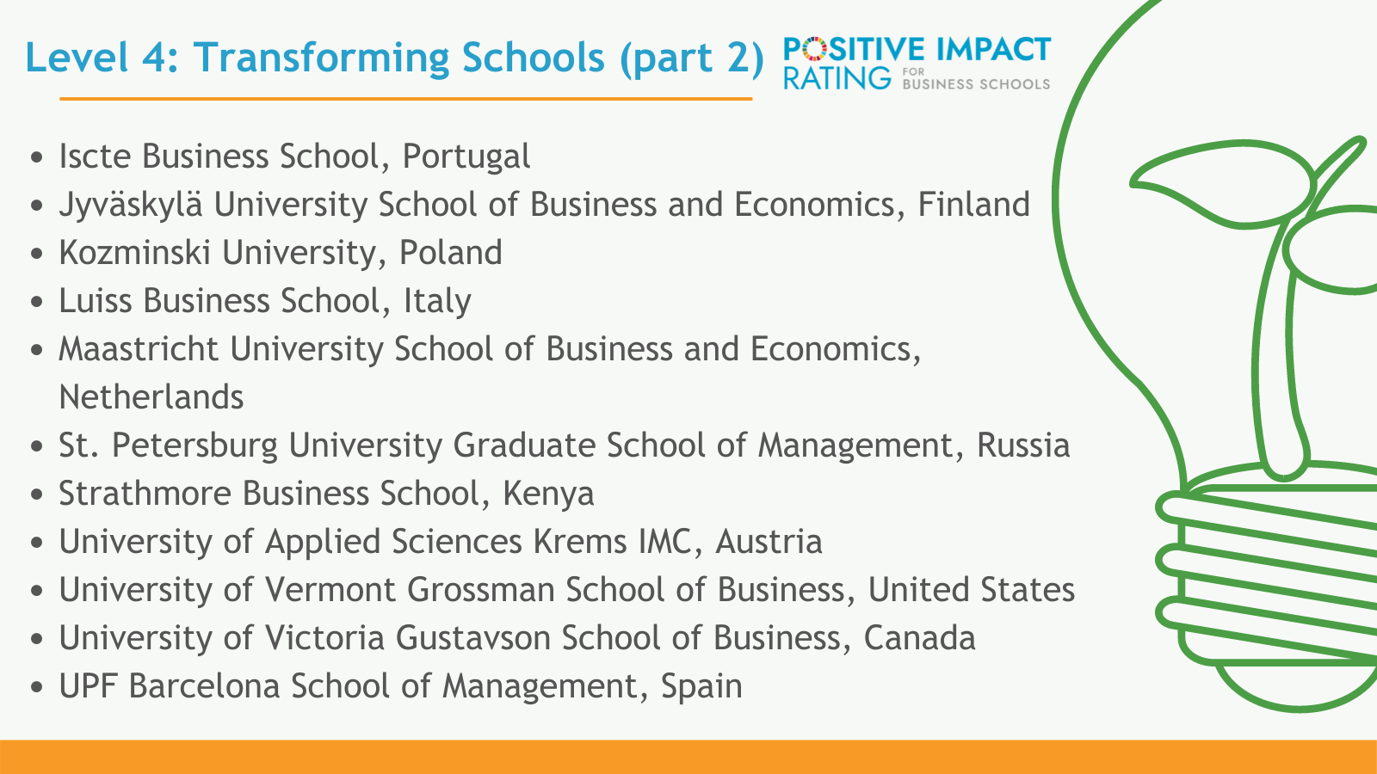
Which schools took part in 2021?

Slide 7
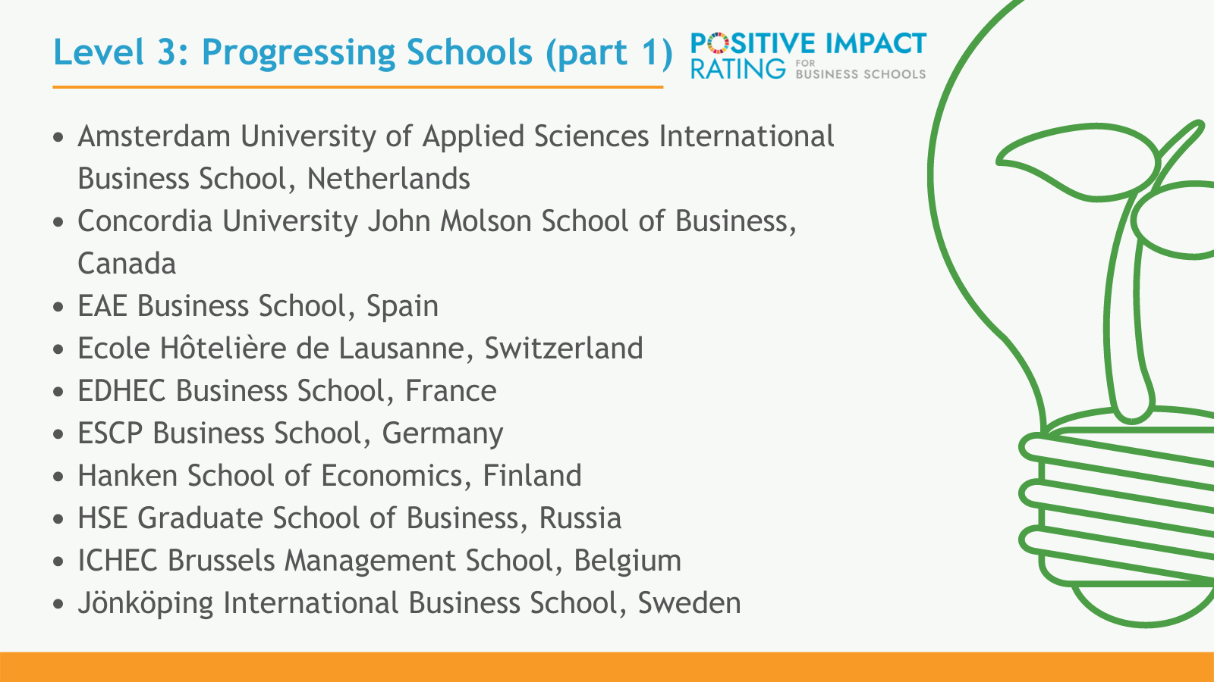
Which schools took part in 2021?

Slide 8
XXX PIR level 2021
Level 3: Progressing Demonstrating evidence of results across some impact dimensions

Slide 9
XXX PIR level 2021
Level 4: Transforming ​ Positive impact culture, embedded in governance and systems, with visible results and progress in many impact dimensions

Slide 10
XXX PIR level 2021
Level 5: Pioneering ​ Unique, sustaining global leadership progress in all impact dimensions

